Slide 1

23 -24 Marzo 2018

Slide 2

Tuberculosis
Fact sheet
Reviewed January 2018
Key facts
Tuberculosis (TB) is one of the top 10 causes of death worldwide.
In 2016, 10.4 million people fell ill with TB, and 1.7 million died from the disease (including 0.4 million among people with HIV).
In 2016, an estimated 1 million children became ill with TB and 250 000 children died of TB (including children with HIV associated TB).
TB is a leading killer of HIV-positive people: in 2016, 40% of HIV deaths were due to TB.
WHO estimates that there were 600 000 new cases with resistance to rifampicin – the most effective first-line drug, of which 490 000 had MDR-TB.
Globally, TB incidence is falling at about 2% per year. This needs to accelerate to a 4–5% annual decline to reach the 2020 milestones of the End TB Strategy.

Slide 3

In 2016, 58 994 cases of TB were reported in 30 EU/EEA countries:
70.4% were newly diagnosed and 71.0% were laboratory confirmed
thirty-three per cent of all TB cases were of foreign origin, mostly residing in low-incidence countries
children under 15 years of age accounted for 4.1% of all TB cases
multidrug-resistant (MDR) TB was reported for 3.7% of 36 071 cases with drug susceptibility testing (DST) results and continues to be highest (more than 10%) in the three Baltic countries
(XDR) TB was reported for 20.1% of 984 MDR TB cases tested for secondline drug susceptibility

Slide 4
Tubercolosi, incidenza (n. casi per 100.000 ab.), Italia, anni 2006 - 2016

Slide 5
Italy - Tuberculosis case notifications, 2016
Total number of cases | 4.032
TB notification rate | 6,6
New*&Relapses | 3778
Pulmonary | 2820 | (69.9%)
of which smear positive | 1.515 | (53.7%)
Laboratory-confirmed cases | 2.666 | (66.1%)
Mean age of New native TB cases | 51,0 | Years
Mean age of New foreign TB cases | 35,9 | Years
Foreign origin of all TB cases | 2509 | (62.2%)
New (not previously treated) | 3778 | (93.7%)
* Cases with unknown previous treatment included in new cases.
Source: European Centre for Disease Prevention and Control/WHO Regional Office for Europe. Tuberculosis surveillance and monitoring in Europe 2018 – 2016 data. Stockholm: ECDC; 2018 © European Centre for Disease Prevention and Control/WHO Regional Office for Europe, 2018
SURVEILLANCE REPORT Tuberculosis surveillance and monitoring in Europe 2018

Slide 6
Italy – Drug resistance surveillance
Cases with DST results | 2.666 (100.0%)
Estimated RR-TB among notified pulmonary cases N, (best-low-high) | 110-76-150
Pulmonary MDR TB cases notified of which XDR TB cases | 33 (1,7%) 5 (11.4 %)
Notified MDR TB of which XDR TB cases | 70 (2.6%) 7 (12.7%)
Source: European Centre for Disease Prevention and Control/WHO Regional Office for Europe. Tuberculosis surveillance and monitoring in Europe 2018 – 2016 data. Stockholm: ECDC; 2018 © European Centre for Disease Prevention and Control/WHO Regional Office for Europe, 2018
SURVEILLANCE REPORT Tuberculosis surveillance and monitoring in Europe 2018

Slide 7
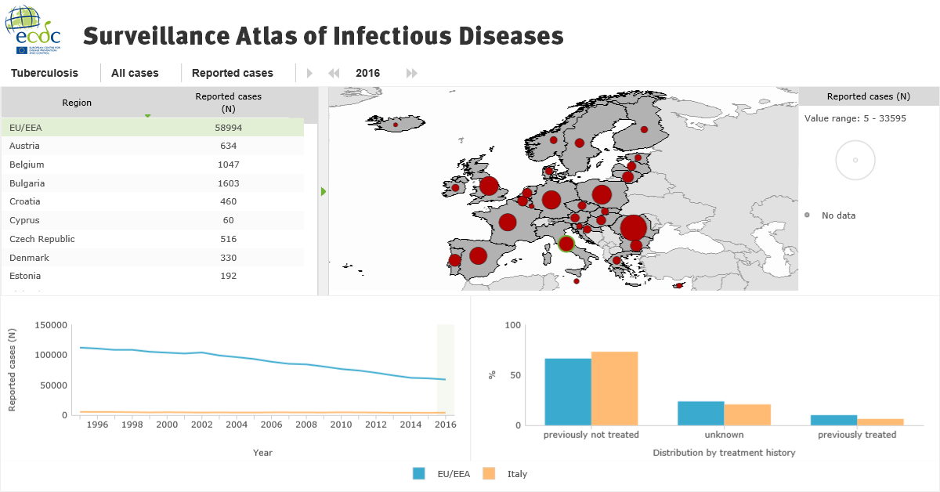
73%
20.7%
6.3%

Slide 8
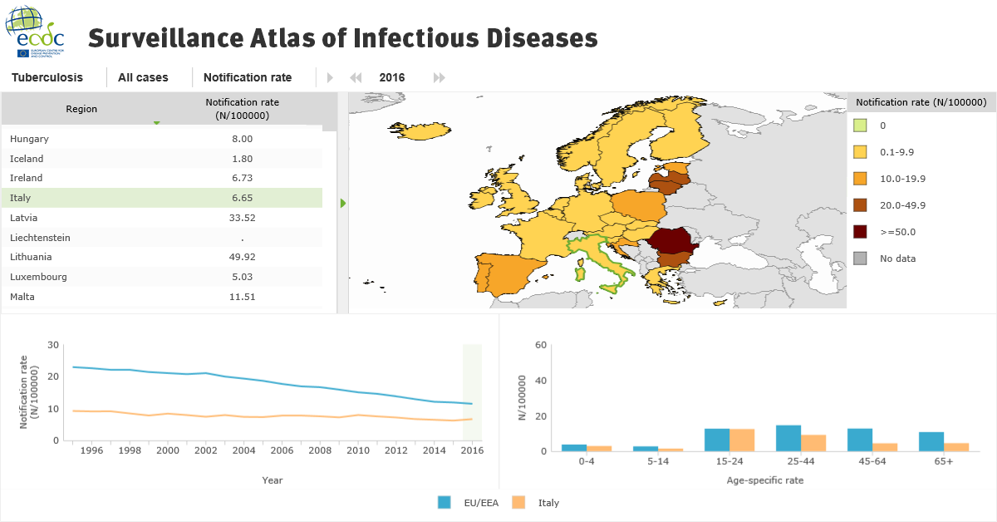
GN | 39 | 1 | 40
PH | 41
PE | 45
SO | 48 | 5 | 53
CI | 51
BD | 53 | 2 | 55
IN | 57
GM | 81 | 12 | 93
NG | 86 | 12 | 98
SN | 97 | 13 | 110
PK | 104 | 12 | 116
MA | 146 | 6 | 152
PG | 325
RO | 366 | 23 | 389
12.42%

Slide 9
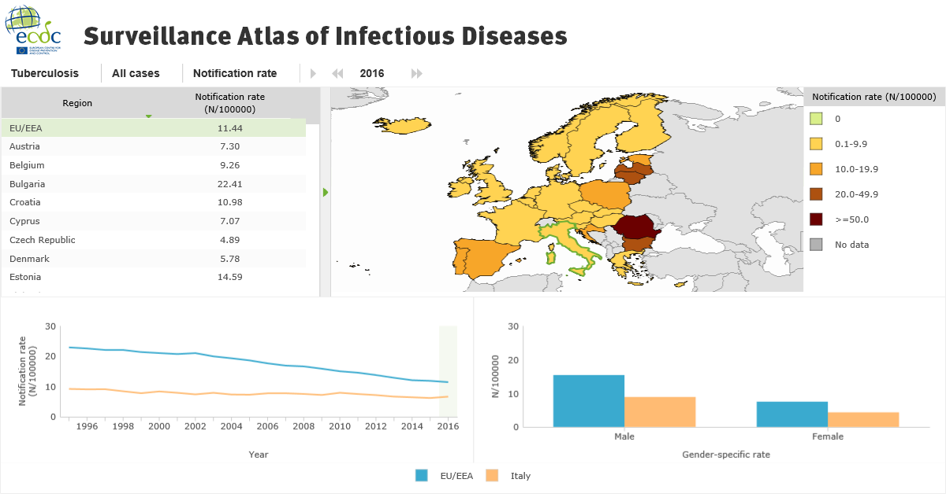
66%

Slide 10
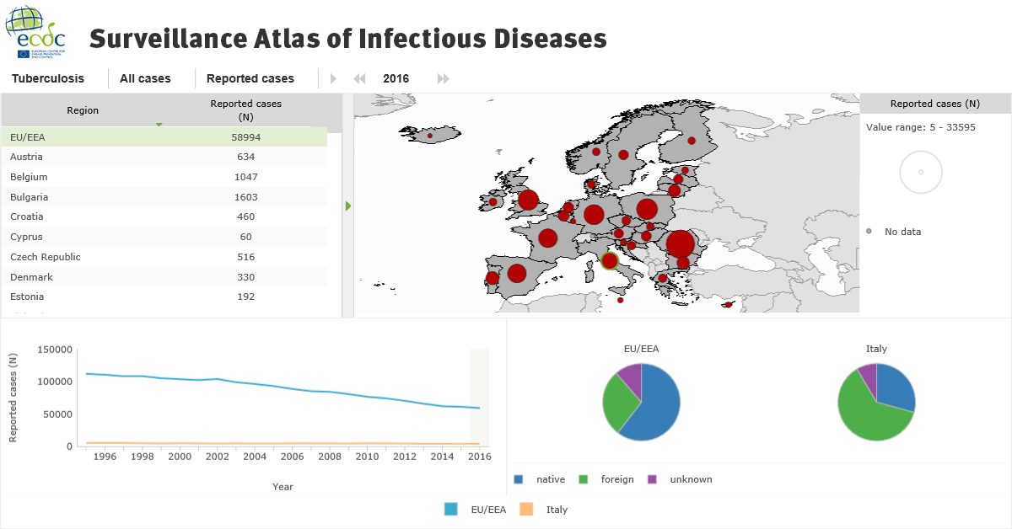

29.2%
62.2%
8.5%

Slide 11
La Regione europea ha sviluppato un suo specifico piano di azione per gli anni 2016-2020
Gli obiettivi specifici per il 2020 sono:
ridurre del 35% i decessi per TB
ridurre l’incidenza della TB del 25%
raggiungere un tasso di successo del trattamento del 75% tra la coorte di casi di TB multiresistenti (Mdr-TB).
Le attività da mettere in atto sono relative a tre aree di intervento:
assistenza (prevenzione e cura) integrata e centrata sul paziente
politiche e sistemi di supporto
intensificazione della ricerca e dell’innovazione.

Slide 12
Conclusioni
Notifica da parte dei laboratori delle persone con un esame batteriologico (diretto, coltura, ecc.) positivo per tubercolosi su campioni respiratori;
Monitoraggio dell’esito del trattamento almeno per tutti i casi polmonari;
Rilevazione di dati sulla farmacoresistenza;
Integrazione dei dati provenienti da queste fonti informative con la notifica;
Rilevazione di dati sulla resa dei programmi di screening, con particolare riguardo ai contatti di caso.

